Slide 1
Een Titel lmao
Een ondertitel

Slide 2
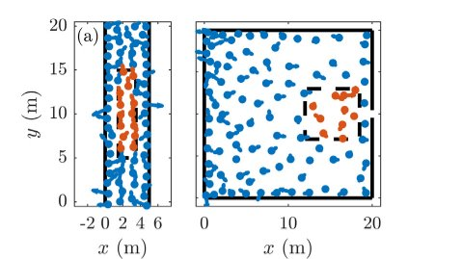
Methods Experimental
Experimental methods
People
Individual speed
Bottleneck evaluation (type 1)
Unidirectional flow (type 2)
Notes:
​Dingen die Annabelle gebruikt en verduidelijkt moeten worden:​
-individual speed (= de v_i onder modelling?)​
-2 soorten experimenten : bottleneck evacuation en unidirectional flow (In orde)​
​
Data van eerdere exeperimenten (references 21 & 22): videos; trajectories aangeuid (zie image) -> velocity time series via Gaussian derivative kernel (references 23-25)​
Wtf is een Gaussian derivative kernel???!!! Internet is echt useless​
​
​

Slide 3



Methods Modeling
Model → acceleration
Interactions
Desired speed
Relaxation time
Potential
Helbing-Molnar
Lennard-Jones
Notes:
Waarom maakt deze paper het zo verdomd moeilijk info te vinden​
​
Modelling data: Helbing-Molnar model & Social Distance model (references 26 & 20)​
F_ij = repulsive interaction​
F_iW = interaction with wall​
v^d = desired speed​
Tau = relaxation time​
​
-Helbing-Molnar: exponential potential​
​
-Social Distance: Lennard-Jones-like potential​
​
Bottleneck: 100 individuals in 20x20 m² room, door 0.92 m width​
Unidirectional flow: 100 individuals in 20 m long corridor, 5 m width​

Slide 4
Anchor slide

Slide 5
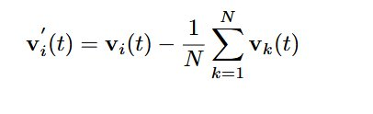
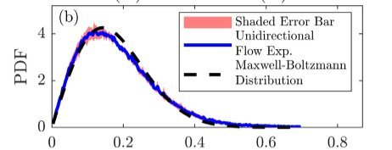

Equilibrium in crowds Maxwell-Boltzmann
Fluctuating velocity
Interrogation area
$v_{i}^{′}(t)$ → PDF
Maxwell-Boltzmann distribution​
Notes:
Problem: could a human croud be in equilibrium, and if so, under wich circomstances​
Instantanous velocity does not incorporate interaction between individuals -> fluctuation velocity (diffrence between individual velocity and mean velocity and the group)​
​
Image: - snapchot of a group in a confined area​
- dot (people) , arrow (individual fluctuation velocity)​
- Interrogation area -> selected region where indivual fluctuating velocity is converted to a probability density function ​
For various cases the PDF has been consrutcted​
Graph -> avaraged PDF , fitted to a 2D maxwel boltzmann distribution​
Pink area: 95% confidence interval that a single PDF is situated in this area​
​

Slide 6
Equilibrium in crowds Collision time
Notes:
Collision time: 'avarage time between to distinct collision of individuals'​
Explanation formula (kan eventueel niet uitgelegd worden in de hoop dat iemand dit als vraag stelt): ​
1/ collision frequency​
- 2r : collision cross section of individuals (r mean distance between individuals)​
Ro: crowd density​
When the collsion time decreases -> mean squared error between best fit and PDF decreases ​
​
PROBLEM STATING:​
Human croud -> inherently non-equilibrium system (convert internal energy into motion)​
Maxwell boltzman distribution applies for systems in equilibrium​
​
​
​

